Slide 1
Traffic Shapping
CBQ
(Class Based Queue)
By
Idris Winarno

Slide 2
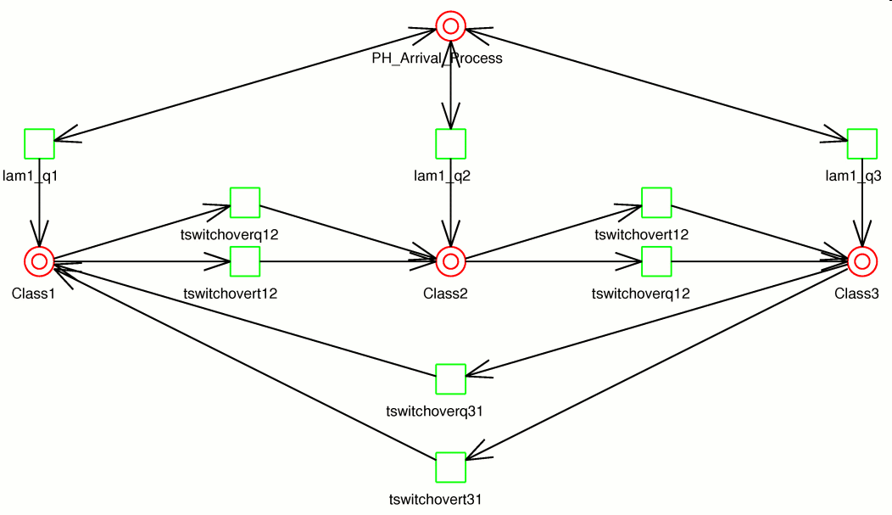
Class Based Queue Model

Slide 3
HOW DOES IT WORK?
Every traffic class must be described by a file in the $CBQ_PATH directory (/etc/shaper by default) - one file per class.
The config file names must obey mandatory format: cbq-<clsid>.<name> where <clsid> is two-byte hexadecimal number in range <0002-FFFF> (which in fact is a CBQ class ID) and <name> is the name of the class -- anything to help you distinguish the configuration files. For small amount of classes it is often possible (and convenient) to let <clsid> resemble bandwidth of the class.
Example of valid config name:
cbq-1280.My_first_shaper

Slide 4
CBQ parameters
Device parameters
Class parameters
TBF qdisc parameters
SFQ qdisc parameters
Filter parameters
Time ranging parameters

Slide 5
Device Parameters
DEVICE=<ifname>,<bandwidth>[,<weight>] Mandatory
DEVICE=eth0,10Mbit,1Mbit
<ifname> is the name of the interface you want to control
traffic on, e.g. eth0
<bandwidth> is the physical bandwidth of the device, e.g. for
ethernet 10Mbit or 100Mbit, for arcnet 2Mbit
<weight> is tuning parameter that should be proportional to
<bandwidth>. As a rule of thumb: <weight> = <bandwidth> / 10
When you have more classes on one interface, it is enough to specify
<bandwidth> [and <weight>] only once, therefore in other files you only
need to set DEVICE=<ifname>.

Slide 6
Class Parameters
RATE=<speed> Mandatory
RATE=5Mbit
Bandwidth allocated to the class. Traffic going through the class is shaped to conform to specified rate. You can use Kbit, Mbit or bps, Kbps and Mbps as suffices. If you don't specify any unit, bits/sec are used. Also note that "bps" means "bytes per second", not bits..
WEIGHT=<speed> Mandatory
WEIGHT=500Kbit
Tuning parameter that should be proportional to RATE. As a rule of thumb, use WEIGHT ~= RATE / 10.
PRIO=<1-8> optional, default 5
PRIO=5
Priority of class traffic. The higher the number, the lesser
the priority. Priority of 5 is just fine.

Slide 7
Class Parameters Cont’d
PARENT=<clsid> optional, default not set
PARENT=1280
Specifies ID of the parent class to which you want this class be
attached. You might want to use LEAF=none for the parent class as
mentioned below. By using this parameter and carefully ordering the
configuration files, it is possible to create simple hierarchical
structures of CBQ classes. The ordering is important so that parent
classes are constructed prior to their children.
LEAF=none|tbf|sfq optional, default "tbf"
Tells the script to attach specified leaf queueing discipline to CBQ
class. By default, TBF is used. Note that attaching TBF to CBQ class
shapes the traffic to conform to TBF parameters and prevents the class
from borrowing bandwidth from its parent even if you have BOUNDED set
to "no". To allow the class to borrow bandwith (provided it is not
bounded), you must set LEAF to "none" or "sfq".
If you want to ensure (approximately) fair sharing of bandwidth among
several hosts in the same class, you might want to specify LEAF=sfq to
attach SFQ as leaf queueing discipline to that class.

Slide 8
Class Parameters Cont’d
BOUNDED=yes|no optional, default "yes"
If set to "yes", the class is not allowed to borrow bandwidth from its parent class in overlimit situation. If set to "no", the class will be allowed to borrow bandwidth from its parent.
Note: Don't forget to set LEAF to "none" or "sfq", otherwise the class will have TBF attached to itself and will not be able to borrow unused bandwith from its parent.
ISOLATED=yes|no optional, default "no"
If set to "yes", the class will not lend unused bandwidth to its children.

Slide 9
Filter parameters
RULE=[[saddr[/prefix]][:port[/mask]],][daddr[/prefix]][:port[/mask]]
These parameters make up "u32" filter rules that select traffic for each of the classes. You can use multiple RULE fields per config. The optional port mask should only be used by advanced users who understand how the u32 filter works.
Some examples:
RULE=10.1.1.0/24:80
selects traffic going to port 80 in network 10.1.1.0
RULE=10.2.2.5
selects traffic going to any port on single host 10.2.2.5
RULE=10.2.2.5:20/0xfffe
selects traffic going to ports 20 and 21 on host 10.2.2.5
RULE=:25,10.2.2.128/26:5000
selects traffic going from anywhere on port 50 to
port 5000 in network 10.2.2.128
RULE=10.5.5.5:80,
selects traffic going from port 80 of single host 10.5.5.5

Slide 10
Time Ranging Parameters
TIME=[<dow>,<dow>, ...,<dow>/]<from><till>;<rate>/<weight>[/<peak>]
TIME=0,1,2,5/18:00-06:00;256Kbit/25Kbit
TIME=60123/18:00-06:00;256Kbit/25Kbit
TIME=18:00-06:00;256Kbit/25Kbit
This parameter allows you to differentiate the class bandwidth throughout the day. You can specify multiple TIME parameters, if the times overlap, last match is taken. The fields <rate>, <weight> and <peak> correspond to parameters RATE, WEIGHT and PEAK (which is optional and applies to TBF leaf qdisc only).
You can also specify days of week when the TIME rule applies. <dow> is numeric, 0 corresponds to sunday, 1 corresponds to monday, etc.

Slide 11
Example
Sample configuration file: cbq-1280.My_first_shaper
# --------------------------------------------------------------------------
DEVICE=eth0,10Mbit,1Mbit
RATE=128Kbit
WEIGHT=10Kbit
PRIO=5
RULE=192.128.1.0/24
# --------------------------------------------------------------------------
The configuration says that we will control traffic on 10Mbit ethernet device eth0 and the traffic going to network 192.168.1.0 will be processed with priority 5 and shaped to rate of 128Kbit.
Note that you can control outgoing traffic only. If you want to control traffic in both directions, you must set up CBQ for both interfaces.

Slide 12
Example
+---------+ 192.168.1.1
BACKBONE -----eth0-| linux |-eth1---------*-------[client]
+---------+
Imagine you want to shape traffic from backbone to the client to 28Kbit and traffic in the opposite direction to 128Kbit. You need to setup CBQ on both eth0 and eth1 interfaces, thus you need two config files:
cbq-028.backbone-client
--------------------------------------------------------------------------
DEVICE=eth1,10Mbit,1Mbit
RATE=28Kbit
WEIGHT=2Kbit
PRIO=5
RULE=192.168.1.1
--------------------------------------------------------------------------
cbq-128.client-backbone
--------------------------------------------------------------------------
DEVICE=eth0,10Mbit,1Mbit
RATE=128Kbit
WEIGHT=10Kbit
PRIO=5
RULE=192.168.1.1,
--------------------------------------------------------------------------
Pay attention to comma "," in the RULE field - it denotes source address!

Slide 13
Test your bandwidht
You can use:
  iptraf
  bwm (bandwith monitor)
  nload
  speedometer
  mrtg
  etc.

Slide 14
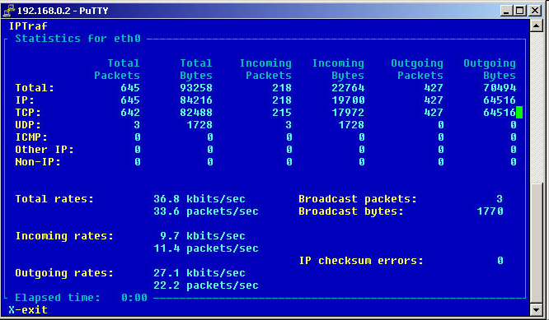
iptraf

Slide 15
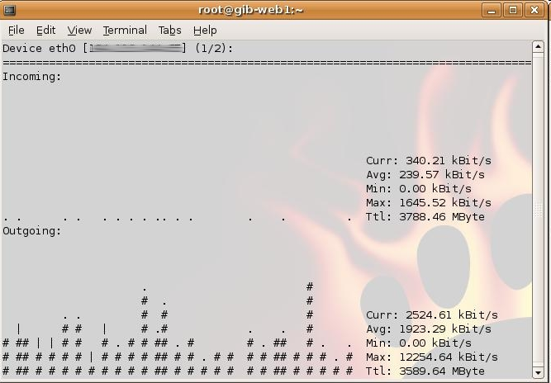
nload

Slide 16
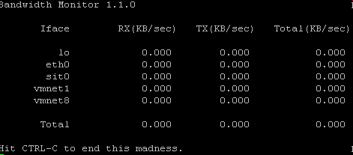
bwm

Slide 17
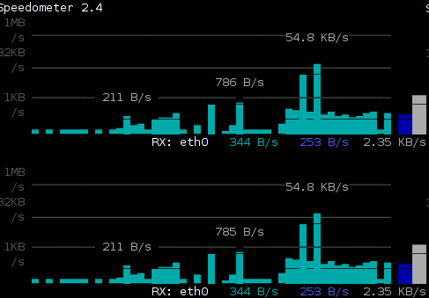
Speedometer

